Slide 1
Introduction To Programming
Player AI Using Minimax, Tic-Tac-Toe

Slide 2
Tic-Tac-Toe
Code: examples/lesson_11/tic_tac_toe_minimax_algorithm/tic_tac_toe.cpp

Slide 3
The Minimax Algorithm
Minimax is a backtracking algorithm, that is used in decision making and game theory to find the optimal move.
It assumes that the opponent also plays optimally.
It can be applied to two-player turn-based games such as Tic-Tac-Toe, Backgammon, Chess, Magic: the Gathering.
For it to work – the game needs to have a terminal state, and the success needs to be calculatable.

Slide 4
The Minimax Algorithm
”In Minimax the two players are called maximizer and minimizer. The maximizer tries to get the highest score possible while the minimizer tries to do the opposite and get the lowest score possible. Every board state has a value associated with it. In a given state if the maximizer has upper hand then, the score of the board will tend to be some positive value. If the minimizer has the upper hand in that board state then it will tend to be some negative value. The values of the board are calculated by some heuristics which are unique for every type of game.”

Slide 5
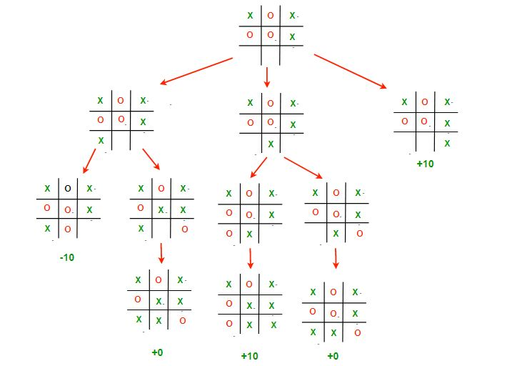
Example outcomes of a Tic-Tac-Toe game from a given state – It is x’s move.
Image source: https://www.geeksforgeeks.org/minimax-algorithm-in-game-theory-set-3-tic-tac-toe-ai-finding-optimal-move/?ref=lbp

Slide 6
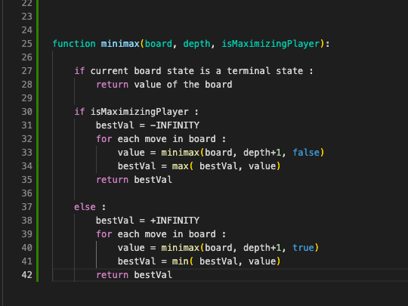
Pseudo-code for minimax

Slide 7
